Slide 1
Welcome to the Shad Rips Powerpoint Presentation
To view the presentation with all the effects,
go to the “Slide Show” Icon in the tool bar above
and then select “View Slide Show”.
Use your keyboard arrow keys
or “return-enter” to advance the slides

Slide 2
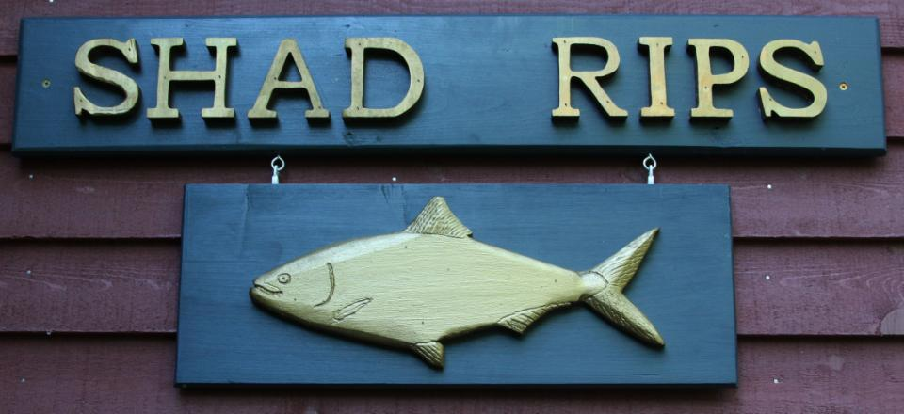
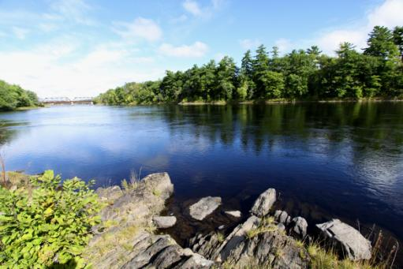
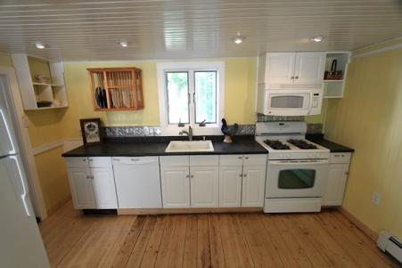

Slide 3
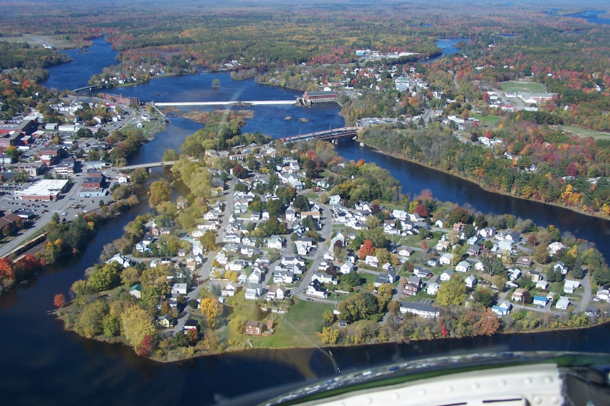
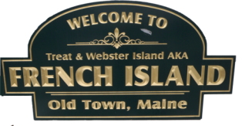
French Island
Great Works Dam will be removed in 2012
Milford
Old Town
Shad Rips inundated by Great Works Dam

Slide 4
The Penobscot River
Abenaki- Meaning "rocky place," or "ledge place
Watch Bald Eagles, Paddle, Fish or Swim from your own private retreat on the Penobscot River located at historic "Shad Rips”, just below Old Town Falls (Milford Dam).
This beautiful setting resides in the quiet
neighborhood at the east end of historic French Island.
Shad Rips is a 3 to 4 bedroom house with a newly renovated bathroom and large kitchen with wide plank floors, ample dry storage and off street parking.

Slide 5
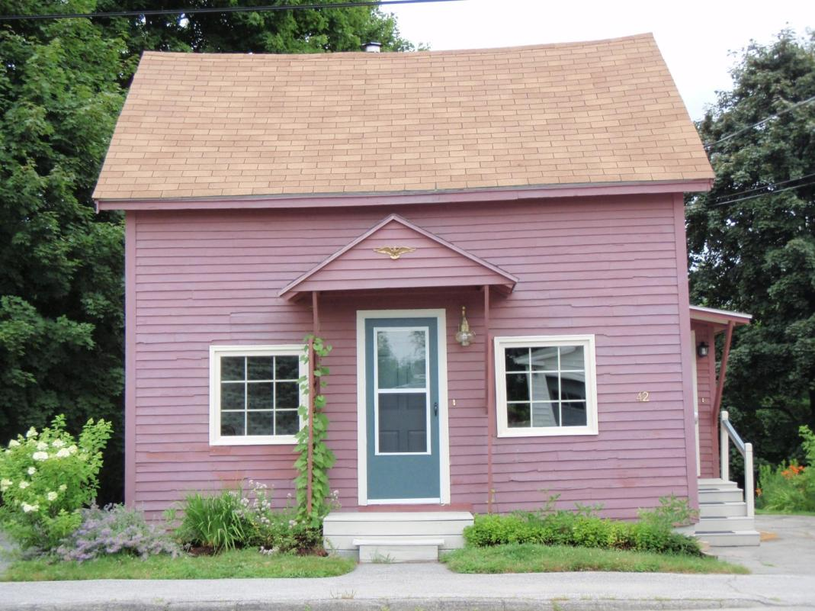
Shad Rips
42 Hayes Street. Old Town, Maine

Slide 6
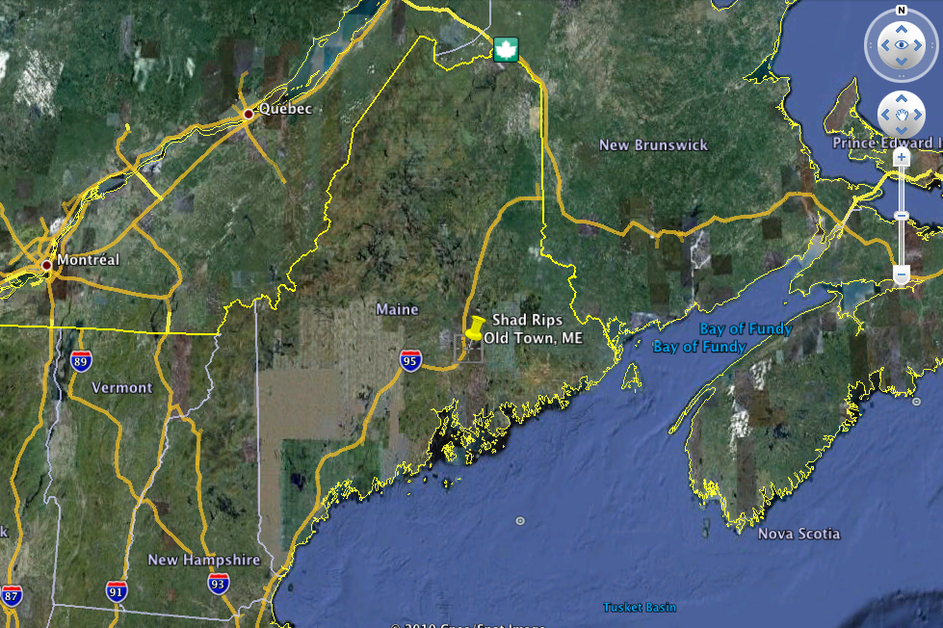

Slide 7
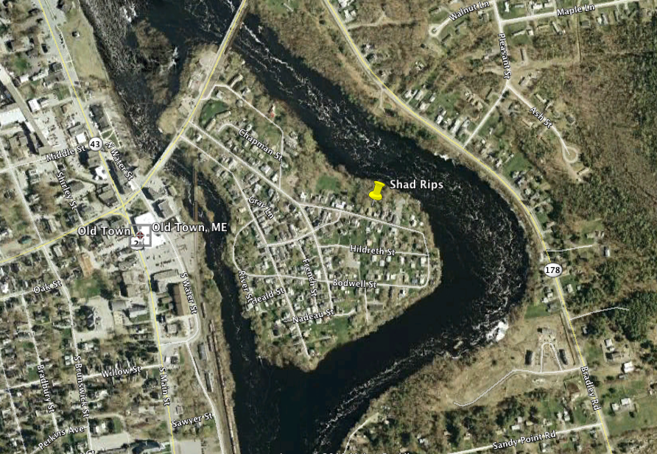
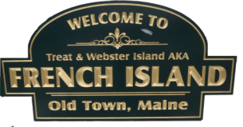

Slide 8
Lets enter the Mudroom from the Paved Drive Way

Slide 9
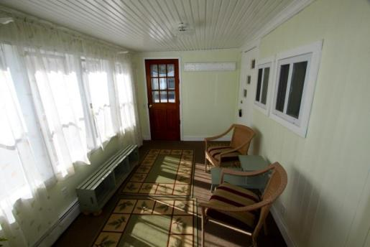
Mudroom
To Kitchen
To Deck

Slide 10
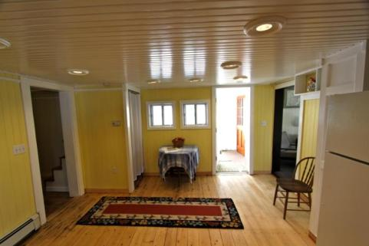
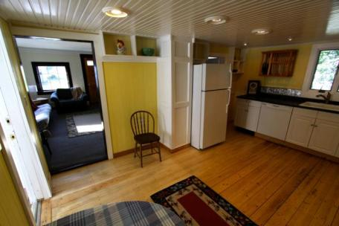
Kitchen
Mudroom
Front Living Room
Dining Room
Bathroom
All New Appliances
Dishwasher & Fridge
New Cabinets
Gas Stove
Microwave and outside vent
Wood Floor
Lots of light!

Slide 11
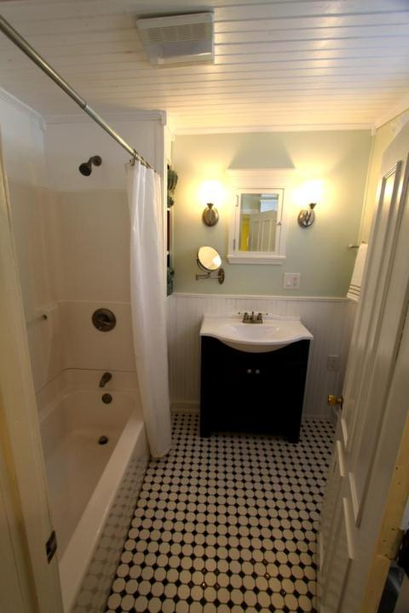
Bathroom
Newly Remodeled
Shower-bath tub
Custom tile floor
Vent to outside

Slide 12
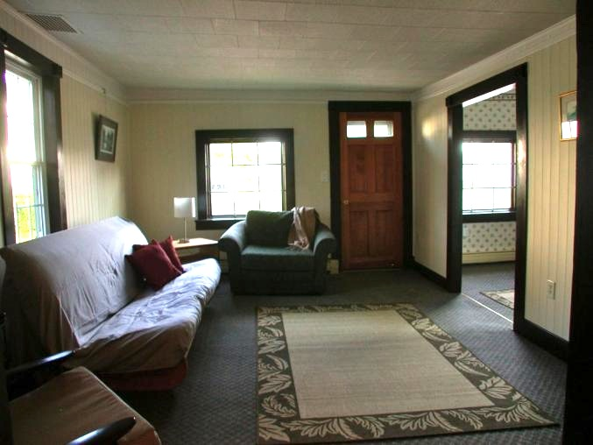
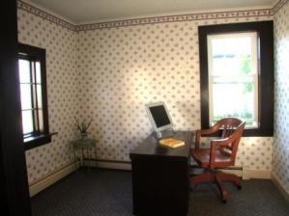
Front Living Room
Front Office
Kitchen
With office space to right

Slide 13
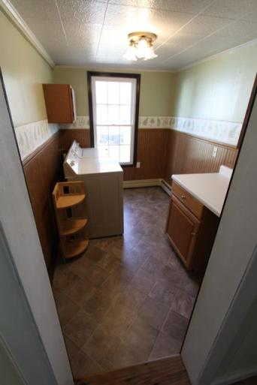
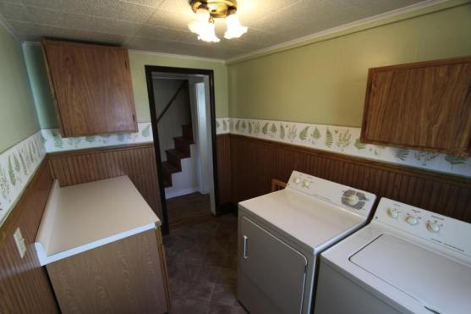
Laundry Room
Looking out
Looking in
Includes Washer and Dryer
Counter space and 2 overhead storage cabinets

Slide 14
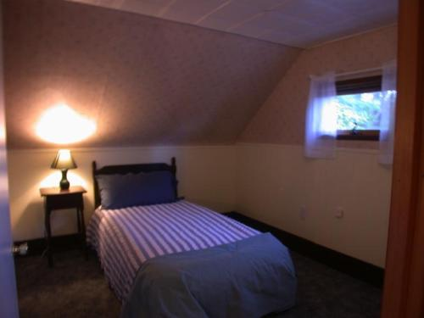
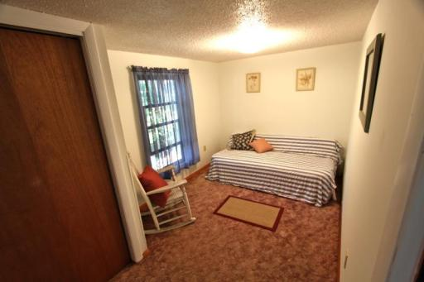
3 Bedrooms
Upstairs
Upstairs
River
All with ample Closet Space!
Closet
Downstairs

Slide 15
Upstairs Living Area
Large Closet
Bedroom or another Office?

Slide 16
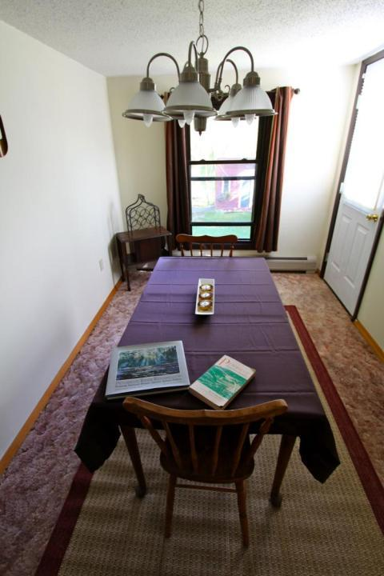
Dining Area
To Deck
Kitchen
River
Downstairs Bedroom
or another office space

Slide 17
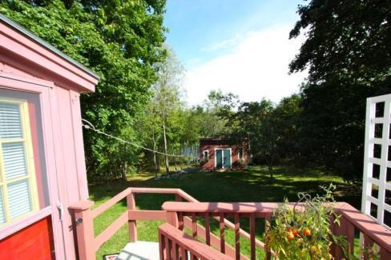
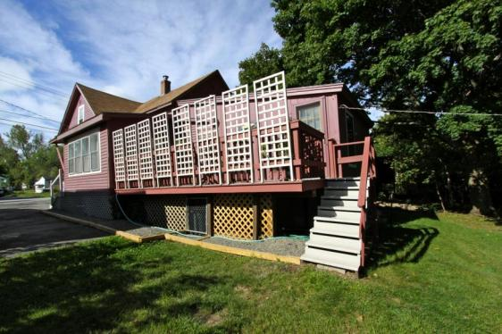
Deck

Slide 18
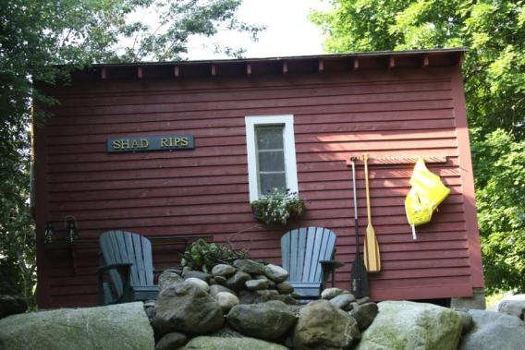
Tool Shed
with electricity
Lot’s more storage space
available in the House Basement
Room for several
Canoes and Kayaks

Slide 19
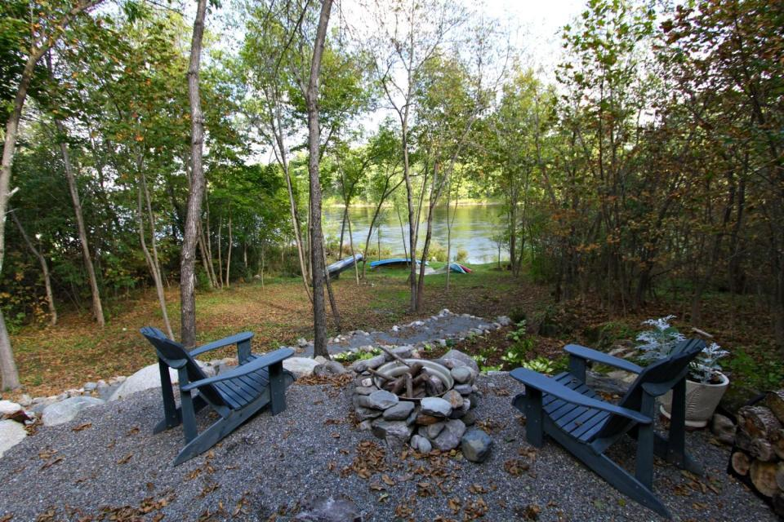
Boulder Patio Overlooks Penobscot River

Slide 20
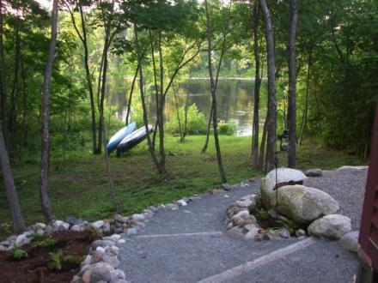
Boulder Patio
Your Private
Scenic Overlook
Enjoy views of eagles and osprey from your very private boulder patio overlooking the river, or have an evening fire in the fire pit. Nicely landscaped low-maintenance lot. The property across the river cannot be developed (Conservation Easement) so you will maintain a tranquil view.

Slide 21
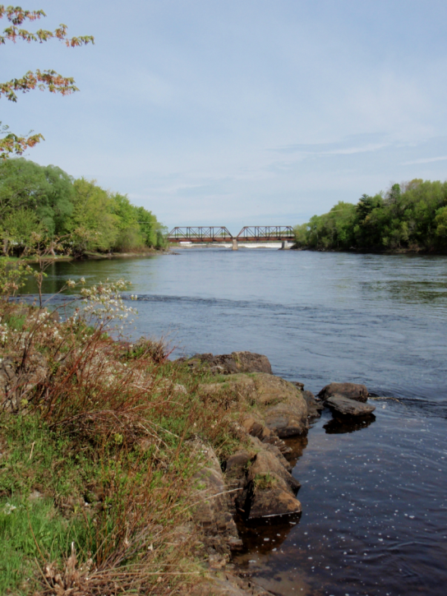
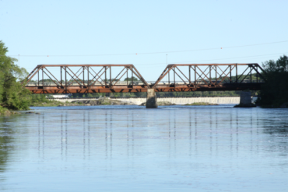
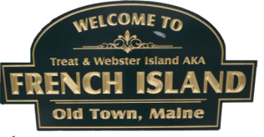
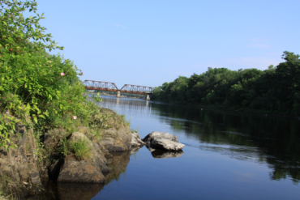
Looking Up River
You will own
This Land!
Shad Rips Property

Slide 22
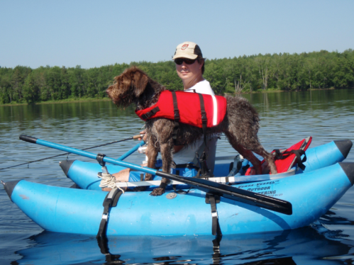
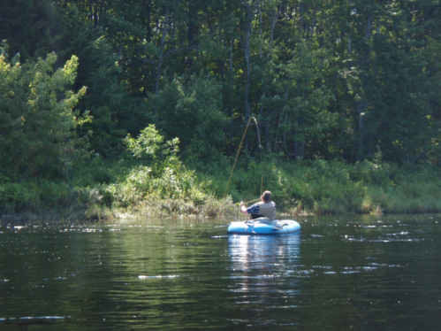
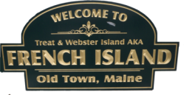
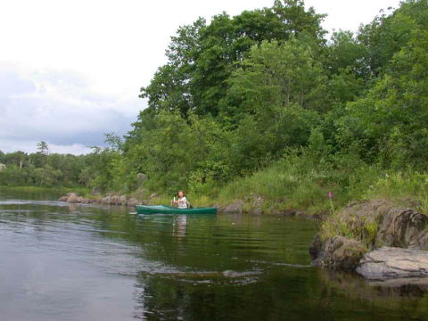
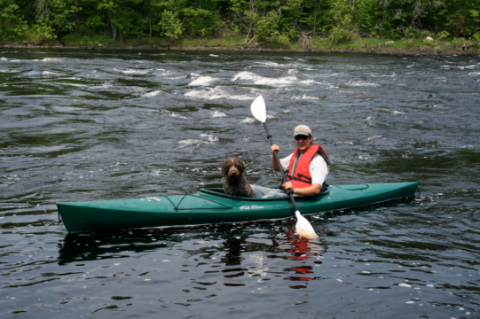
Shad Rips
Property

Slide 23
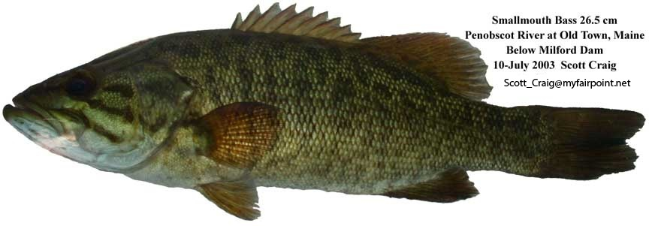

Slide 24
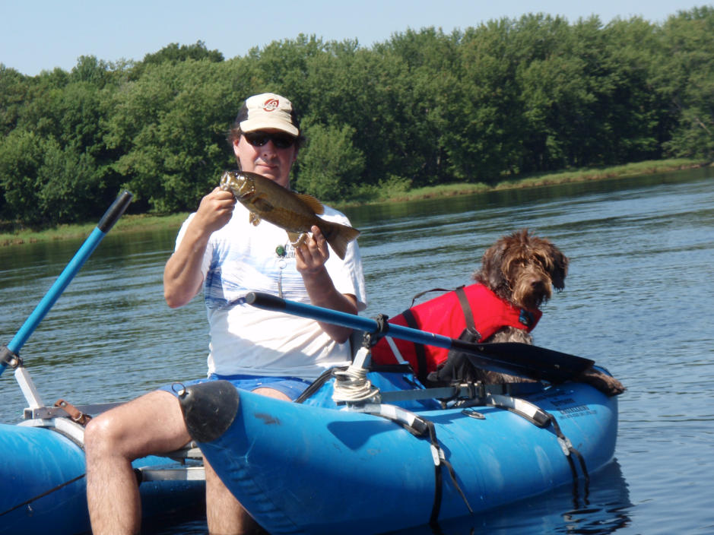

Slide 25
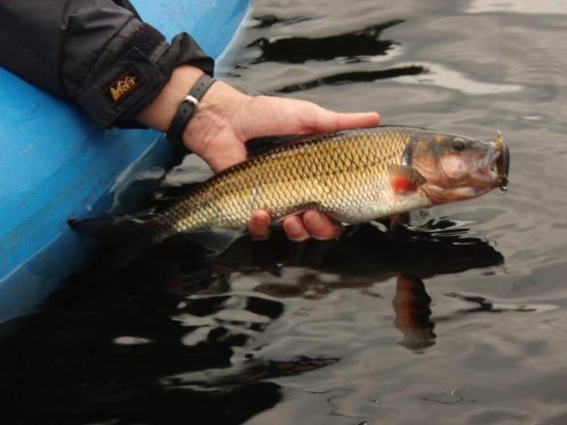
Fallfish

Slide 26
Penobscot Restoration Trust
Click to follow link
Is going to Make “Shad Rips” Ocean Access Property!
10 species of Diadromous fish will once again have free access
to the Penobscot River below Old Town Falls (Milford Dam)
Get Ready for Awesome
American Shad
&
Striped Bass
Fishing from Your Property!

Slide 27
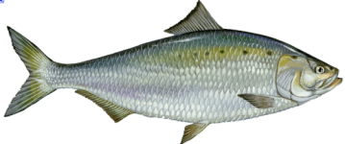
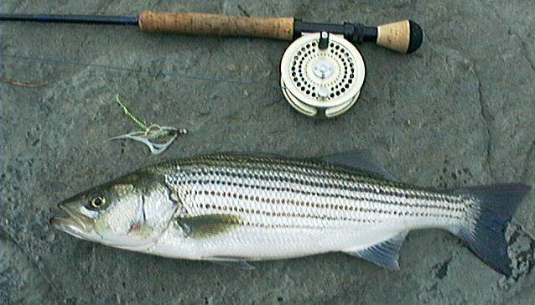
Striped Bass
American Shad

Slide 28
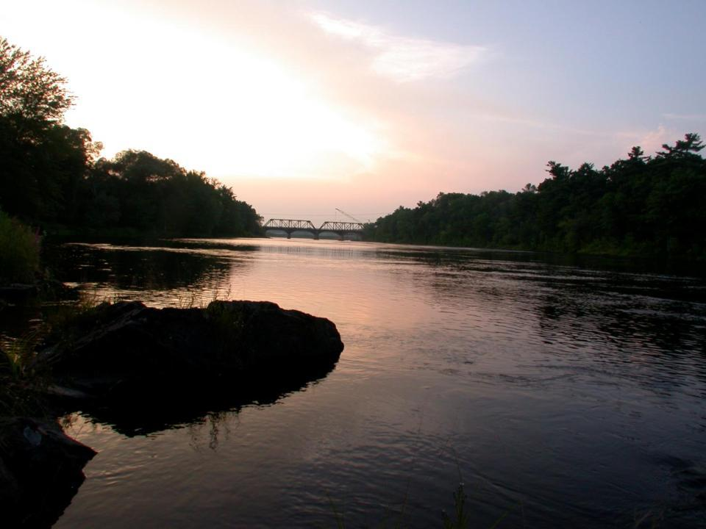
Contact Information
Lifetime
member
Scott Craig
Old Town, Maine
207 827-2202
scott_craig@myfairpoint.net
http://home.myfairpoint.net/~nunatak
Own this
Property
$114k

Slide 29
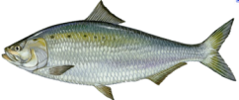
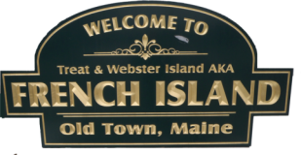
“Shad Rips”
3 Bedrooms (with ample closet space!)
Mudroom (access to kitchen and deck)
Deck attached to house (view of River, access from Dinning area)
1 Bath (recently renovated)
New Kitchen (Dishwasher, Refrigerator, Microwave with outside vent-fan, Wood Floors, Lots of light)
Office space off Living Room area
Laundry Room (washer/dryer included, extra storage area)
Lower Deck (fire ring overlooking Penobscot River)
Storage Shed (with Electricity)
Multiple off street parking areas (space for > 3 vehicles)
Basement (walk in with ample dry storage space- poured concrete floor)
Close to University of Maine (30 min. bike ride, 7 min. drive)
Awesome fishing for Smallmouth Bass- Soon to be American Shad!
Soon to be Ocean Access Waterfront- http://www.penobscotriver.org
Wildlife Viewing and Kayaking from your Home!

